Slide 1
Serialization CSI 211: Object Oriented Programming
Tanjina Helaly

Slide 2
Serialization
Serialization in java is a mechanism of writing the state of an object into a byte stream.
It is mainly used
to store/persist object’s state
travel object's state on the network (known as marshaling).

Slide 3
Deserialization
Deserialization is the process of reconstructing the object from the serialized state. It is the reverse operation of serialization.

Slide 4
Steps for Serialization/Deserialization
Mark the class Serializable
Use ObjectOutputStream to serialize the object
Use ObjectInputStream to deserialize the object

Slide 5
Mark the Class Serializable
To make a object serializable, two conditions must be met:
The class must implement the java.io.Serializable interface.
Serializable is a marker interface (has no body). It is just used to "mark" java classes which support a certain capability.
All of the fields in the class must be serializable. If a field is not serializable, it must be marked transient.
Example:
import java.io.Serializable;
public class Student implements Serializable{
int id;
String name;
public Student(int id, String name) {
this.id = id;
this.name = name;
}
}

Slide 6
Mark the Class Serializable
Once a class implement Serializable interface
all primitive attributes are marked as Serializable
To make the Reference type attributes serializable, those classes must be made serializable as well
Note: All the objects within an object must be Serializable.
Child class inherits the parent’s property. So, all its sub classes will also be serializable.
If there is any static data member in a class, it will not be serialized because static is the part of class not object.
In case of array or collection, all the objects of array or collection must be serializable. If any object is not serialiizable, serialization will be failed.

Slide 7
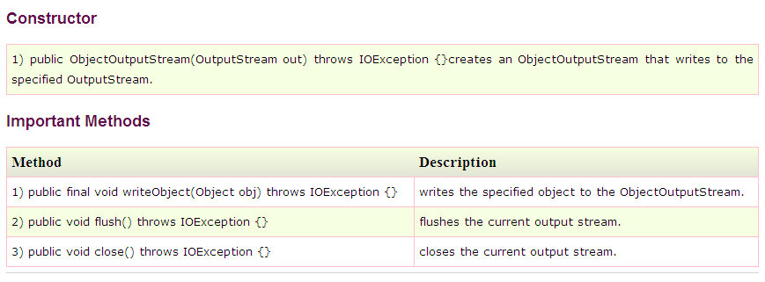
Class Use for Serialization
ObjectOutputStream - stream that contains the methods for serializing

Slide 8
Example code to Serialize
import java.io.*;
class Persist{
public static void main(String args[]) {
try{
Student s1 =new Student(211,"ravi");
FileOutputStream fout=new FileOutputStream("f.txt");
ObjectOutputStream out=new ObjectOutputStream(fout);
out.writeObject(s1);
out.flush();
System.out.println("success");
}
Catch(Exception e){
System.out.println(e.getMessage());
}
}
}

Slide 9
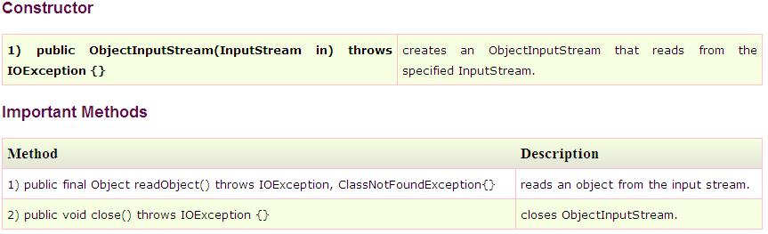
Class Use for De-serialization
ObjectInputStream -stream that contains the methods for deserializing an object.

Slide 10
Example code to Deserialize
import java.io.*;
class Depersist{
public static void main(String args[]) {
try{
ObjectInputStream in=new ObjectInputStream(new FileInputStream("f.txt"));
Student s=(Student)in.readObject();
System.out.println(s.id+" "+s.name);
in.close();
}
catch(Exception e){
System.out.println(e.getMessage());
}
}
}

Slide 11
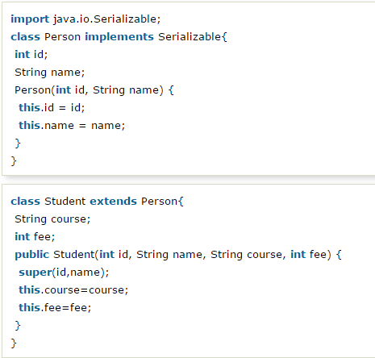
Java Serialization with Inheritance
Example
Parent class properties are inherited to subclasses so if parent class is Serializable, subclass would also be.
Now you can serialize the Student class object that extends the Person class which is Serializable.

Slide 12
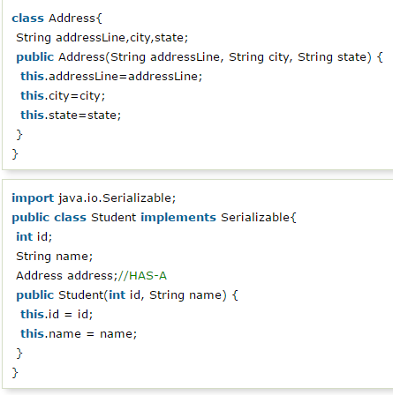
Java Serialization with Aggregation (HAS-A Relationship)
If a class has a reference of another class, all the references must be Serializable otherwise serialization process will not be performed. In such case, NotSerializableException is thrown at runtime.
Since Address is not Serializable, you can not serialize the instance of Student class.
Example

Slide 13
Java Transient Keyword
If you don't want to serialize any data member of a class, you can mark it as transient.
Let’s say I have declared a class as Student, it has three data members id, name and age. If you serialize the object, all the values will be serialized but I don't want to serialize one value, e.g. age then we can declare the age data member as transient.
If you deserialize the object, you will get the default value for transient variable.

Slide 14
Example with Transient
import java.io.Serializable;
public class Student implements Serializable{
int id;
String name;
transient int age;//Now it will not be serialized
public Student(int id, String name,int age) {
this.id = id;
this.name = name;
this.age=age;
}
}

Slide 15
Example with Transient
Code to Serialize
import java.io.*;
class PersistExample{
public static void main(String args[])throws Exception{
Student s1 =new Student(211,"ravi",22);//creating object
//writing object into file
FileOutputStream f=new FileOutputStream("f.txt");
ObjectOutputStream out=new ObjectOutputStream(f);
out.writeObject(s1);
out.flush();
out.close();
f.close();
System.out.println("success");
}
}
Output

Slide 16
Example with Transient
Code to De-Serialize
import java.io.*;
class DePersist{
public static void main(String args[])throws Exception{
ObjectInputStream in=new ObjectInputStream(new FileInputStream("f.txt"));
Student s=(Student)in.readObject();
System.out.println(s.id+" "+s.name+" "+s.age);
in.close();
}
}
Output
211 ravi 0
Notice age is set to 0 as it was marked transient.

